Slide 1
SIMULATION RESULTS FOR ICEM 2018
Özgür - Hande

Slide 2
Parameters
Phase currents
Induced phase voltages
Flux linkages
Torque
Electrical and mechanical power
Under:
Normal operation
Failure of a single coil
Failure of a phase in a module
Failure of a module

Slide 3
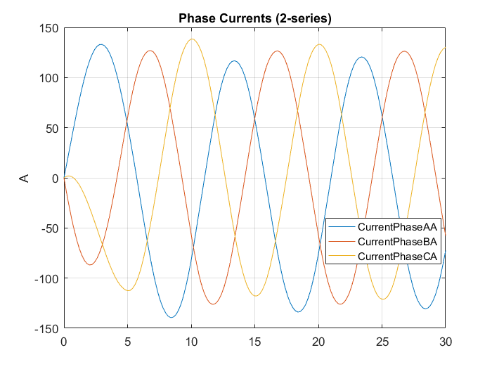
Normal Operation

Slide 4
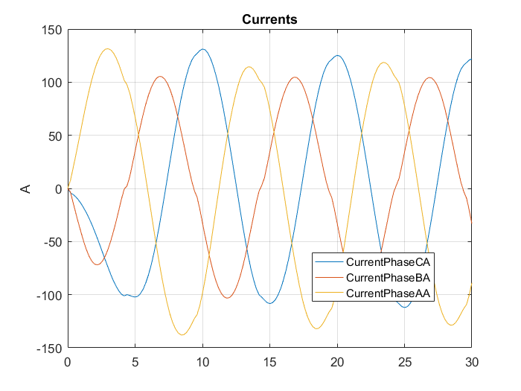
Failure of a Single Coil

Slide 5
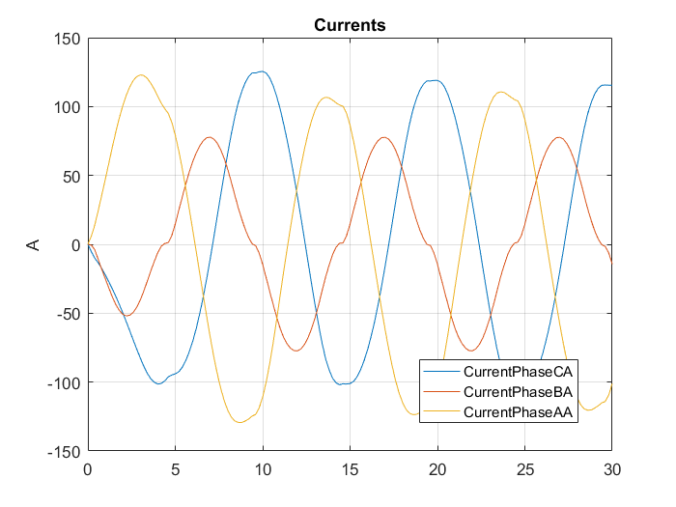
Failure of A Phase (In A Module)

Slide 6
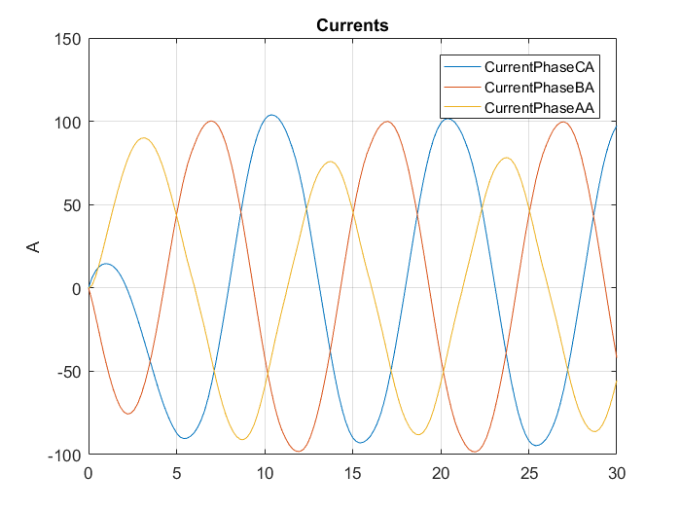
Failure of A Module

Slide 7
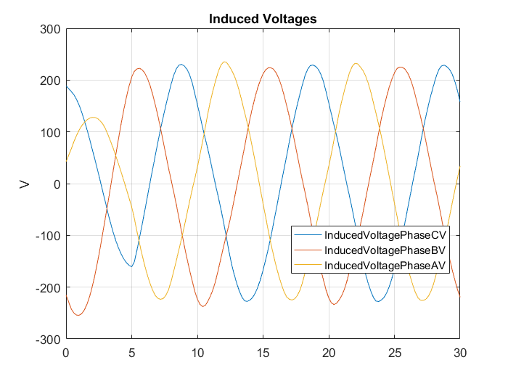
Normal Operation

Slide 8
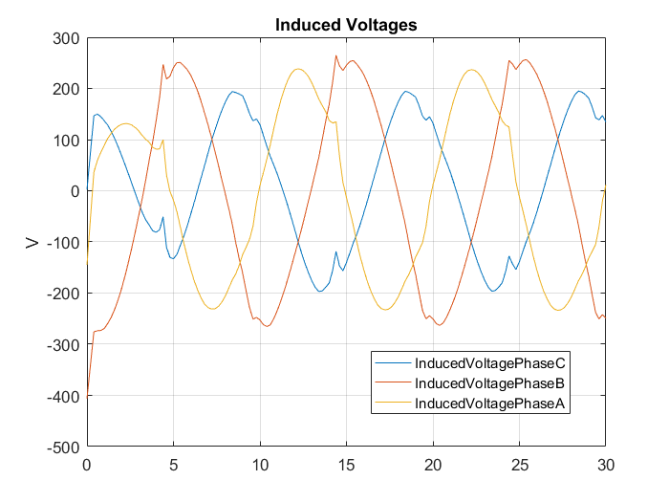
Failure of a Single Coil

Slide 9
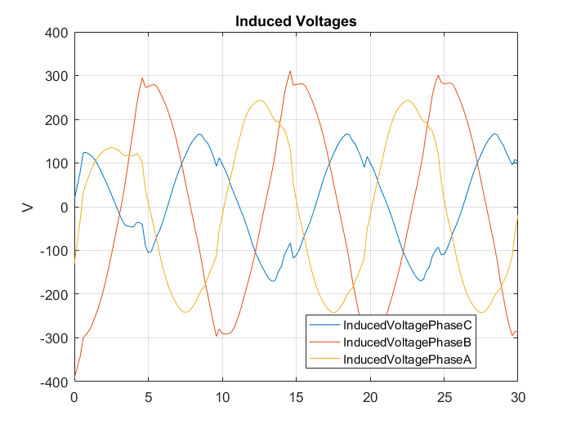
Failure of A Phase (In A Module)

Slide 10
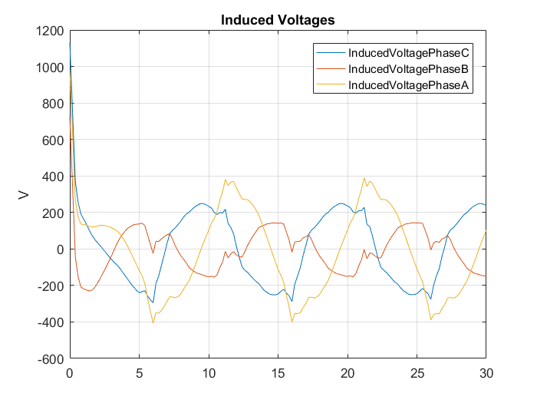
Failure of A Module

Slide 11
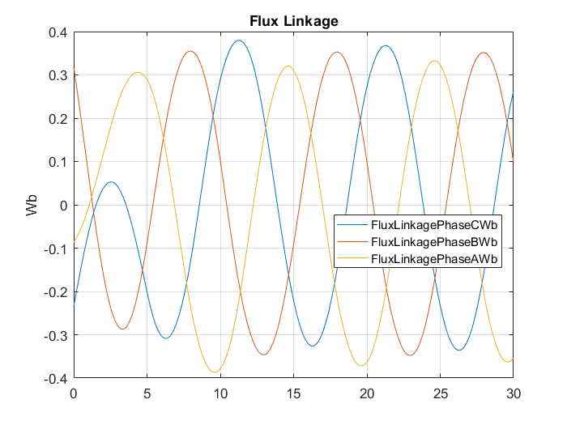
Normal Operation

Slide 12
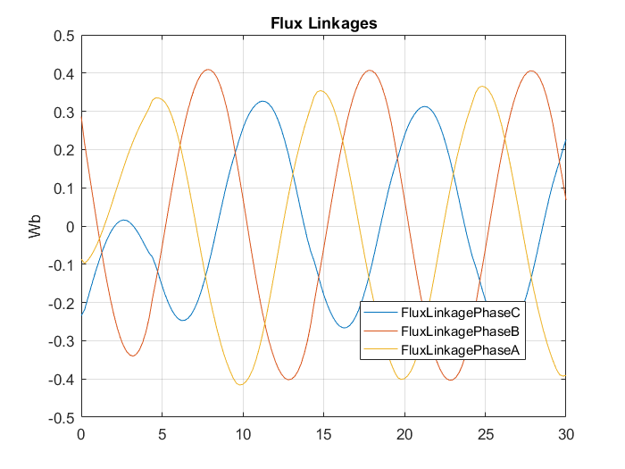
Failure of a Single Coil

Slide 13
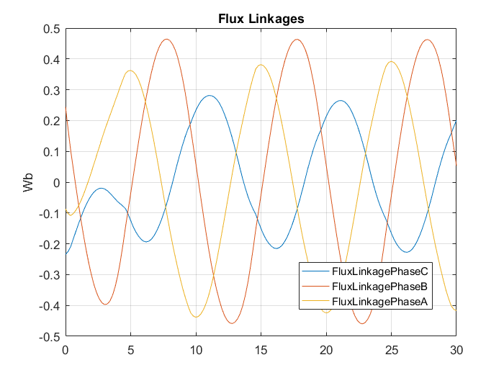
Failure of A Phase (In A Module)

Slide 14
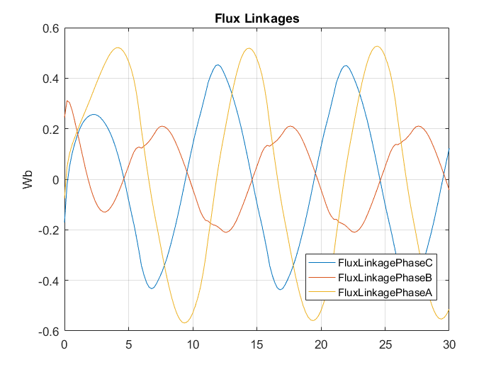
Failure of A Module

Slide 15
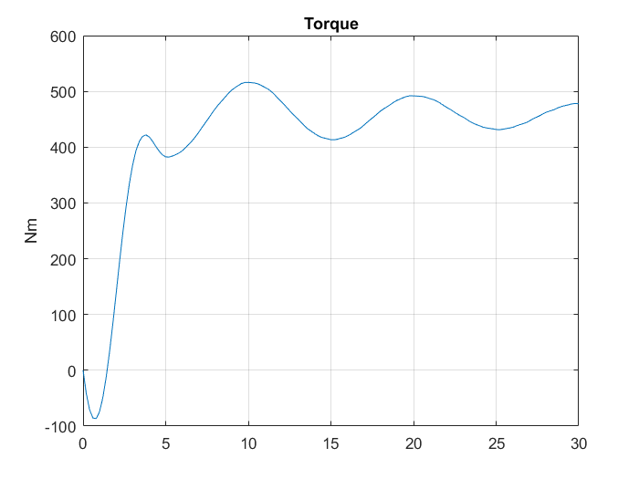
Normal Operation

Slide 16
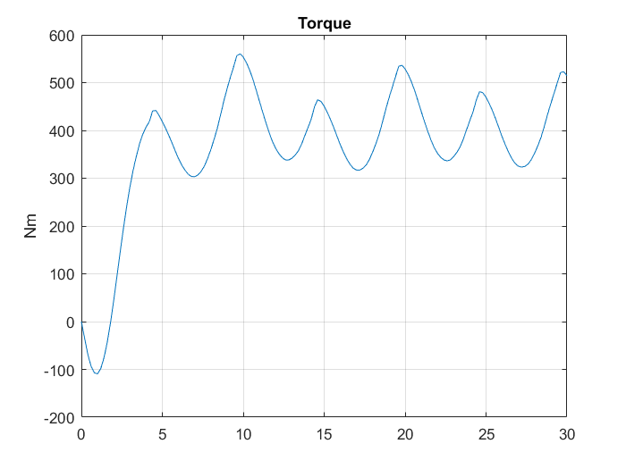
Failure of a Single Coil

Slide 17
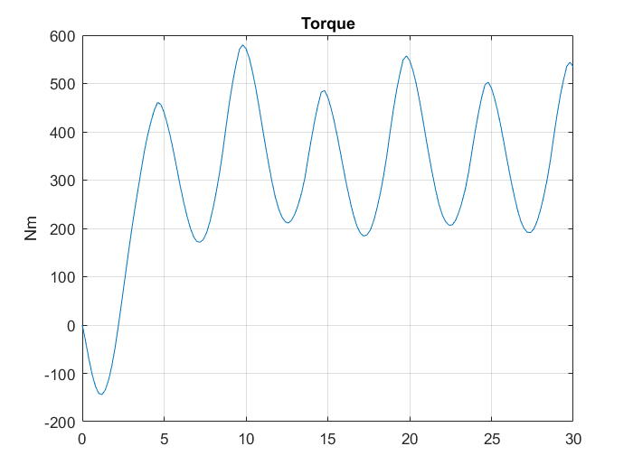
Failure of A Phase (In A Module)

Slide 18
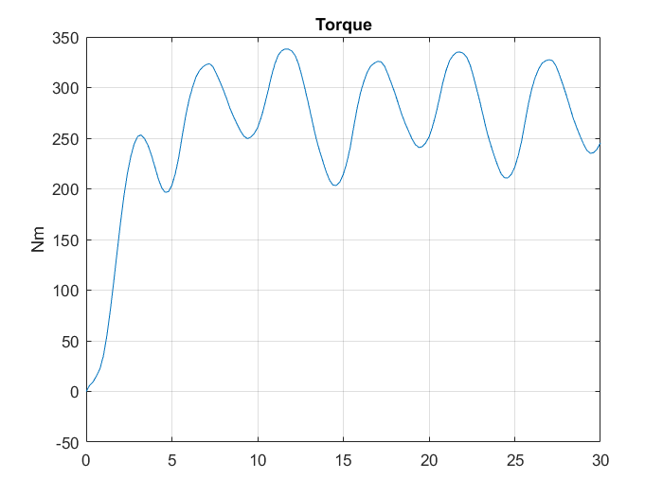
Failure of A Module

Slide 19
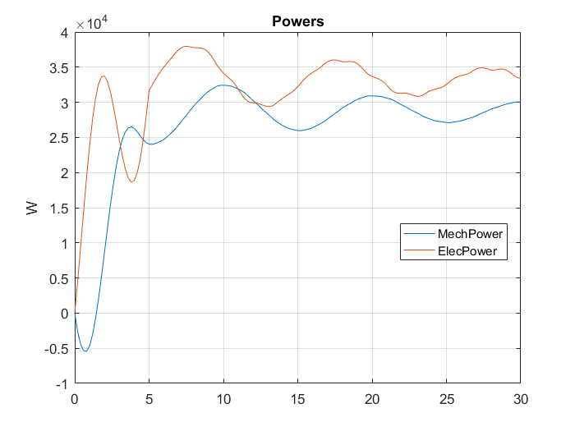
Normal Operation

Slide 20
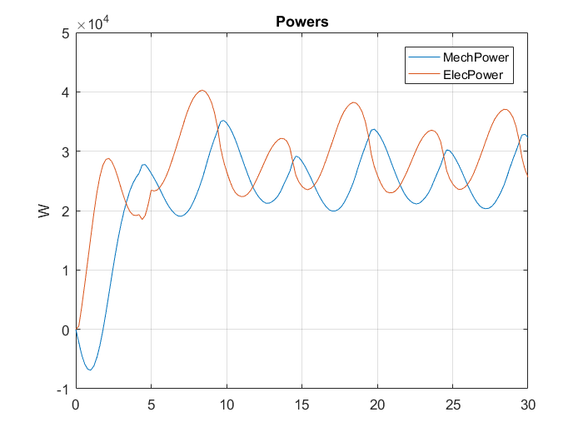
Failure of a Single Coil

Slide 21
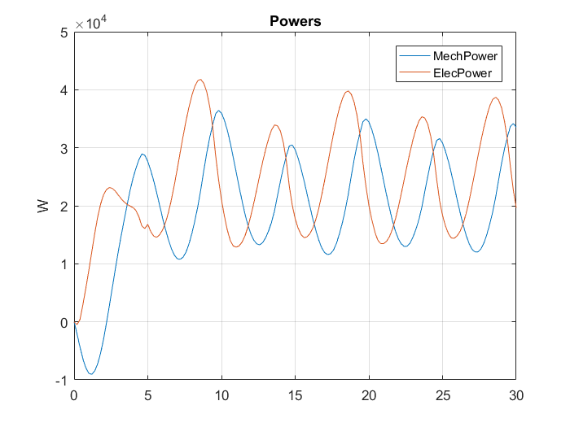
Failure of A Phase (In A Module)

Slide 22
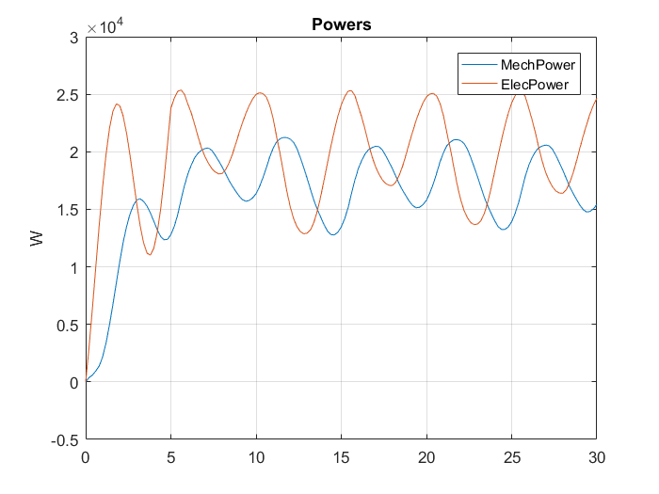
Failure of A Module

